Slide 1
How to Update Firmware on Respimatic 100
Step-by-step Procedure

Slide 2
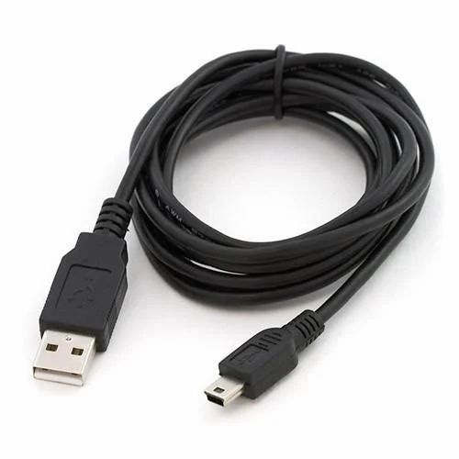
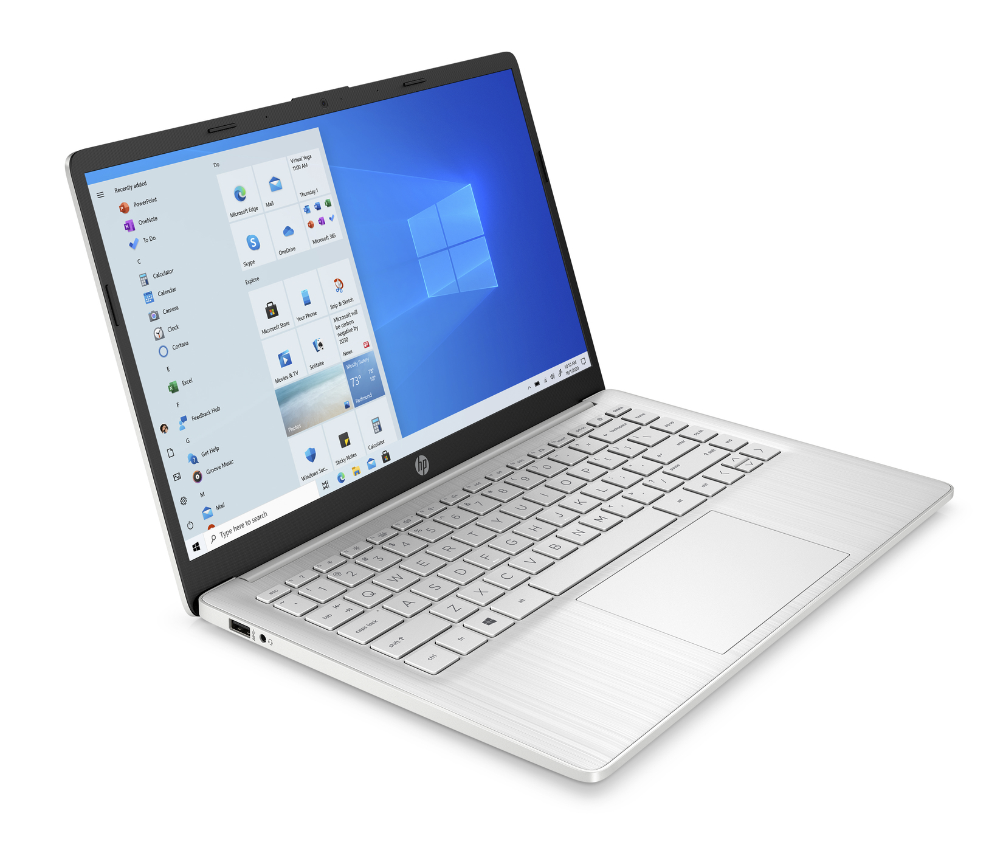
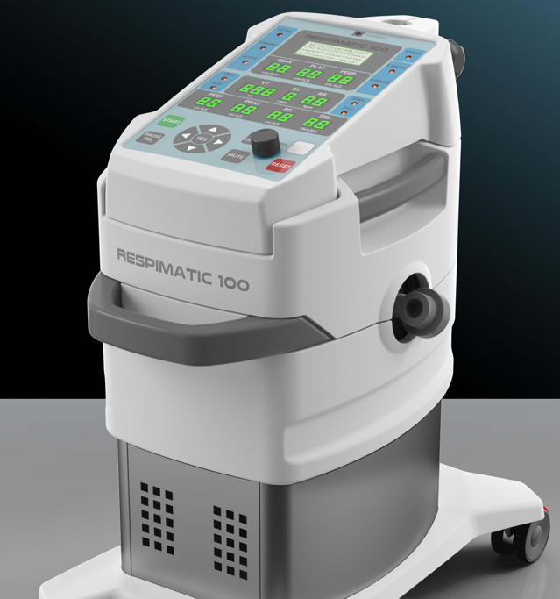
Equipment needed
USB Cable
Windows Laptop
Respimatic 100
One end with
micro-USB connector

Slide 3
Firmware Update Procedure Overview
Install Respimatic Firmware Release
Download Respimatic Firmware Release
One-time Download Arduino Builder
One-time Install Arduino Builder

Slide 4
Download Arduino Builder

Slide 5
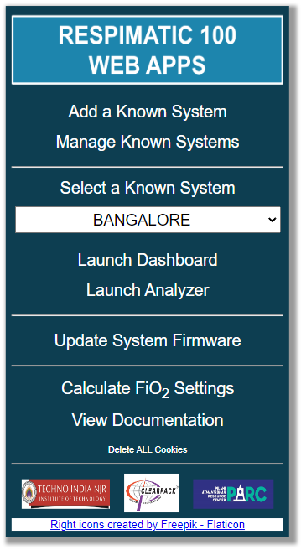
Download Arduino Builder Step 1
Open URL https://www.respimatic.com in your browser
Click on
“Update System Firmware”

Slide 6
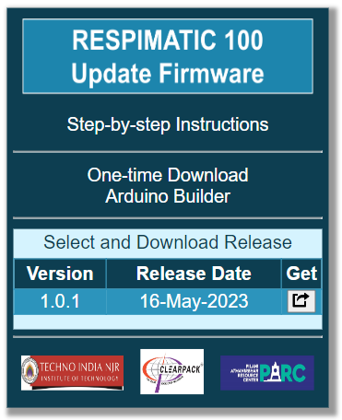
Download Arduino Builder Step 2
Click on
“One-time Download
Arduino Builder”

Slide 7
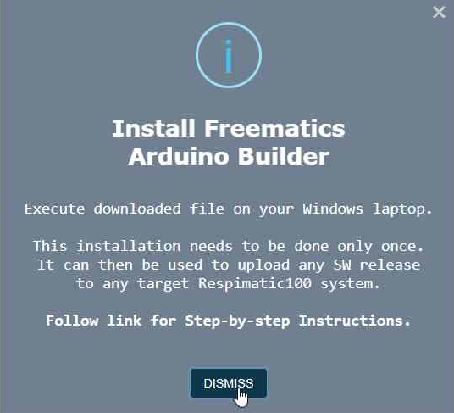
Download Arduino Builder Step 3
The .exe is downloaded to your Downloads folder
Read and Dismiss the information popup

Slide 8
Install Arduino Builder

Slide 9
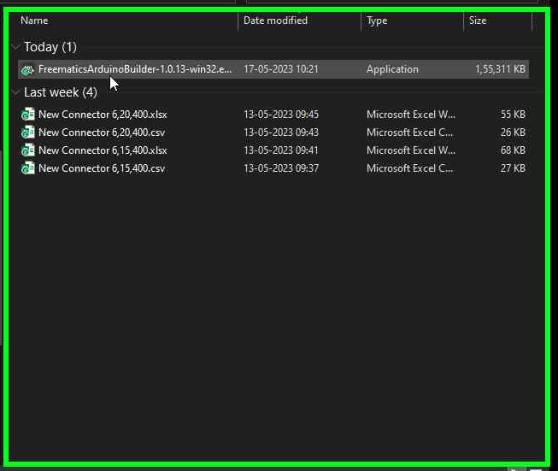
Install Arduino Builder Step 1
Find the downloaded .exe file (in your Downloads folder)
Double Click on the .exe file to execute it
You will need admin privileges on your laptop to execute this file
Your laptop’s anti-virus software will sanitize the file automatically

Slide 10
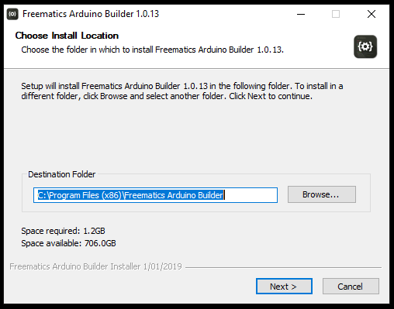
Install Arduino Builder Step 2
The Arduino Builder installer will guide you step-by-step
Click on “Next”

Slide 11
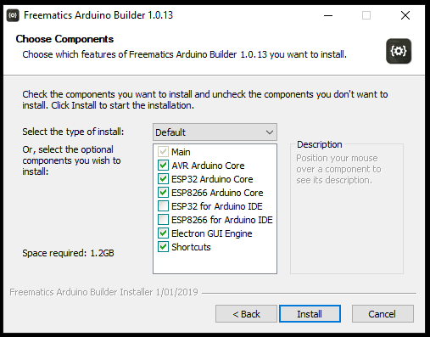
Install Arduino Builder Step 3
Click on “Install”

Slide 12
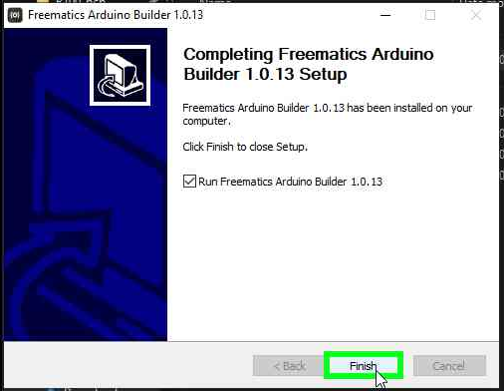
Install Arduino Builder Step 4
Click on “Finish”

Slide 13
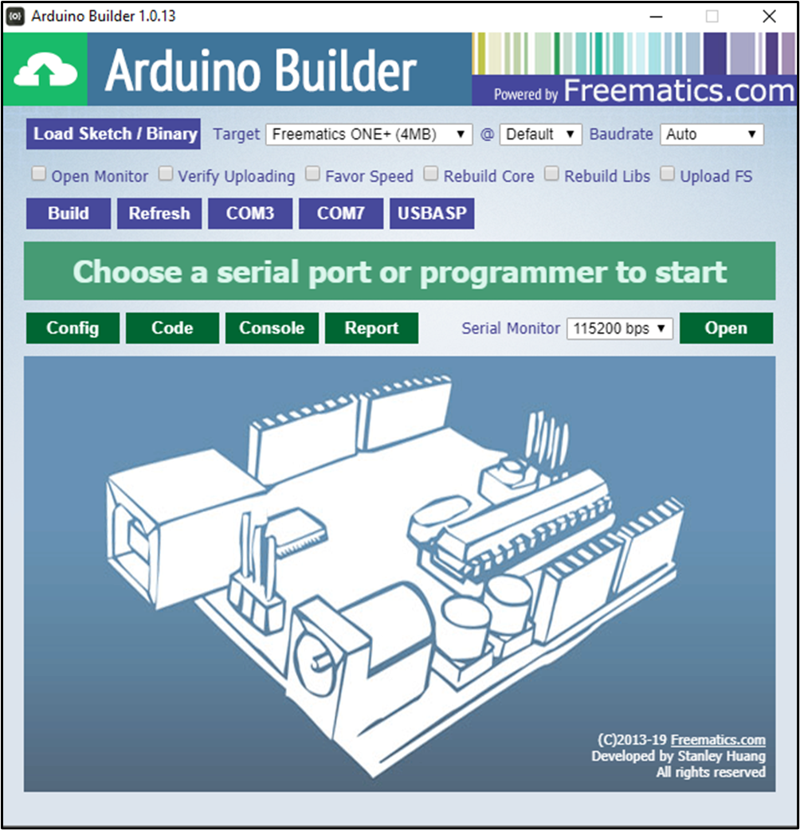
Install Arduino Builder – Step 4
Arduino Builder is installed!
You can now delete the .exe file in your Downloads folder

Slide 14
Download a Firmware Release

Slide 15
Download Firmware Release Step 1
Open URL https://www.respimatic.com in your browser
Click on
“Update System Firmware”

Slide 16
Download Firmware Release Step 2
Click on the download icon button next to the release you wish to download

Slide 17
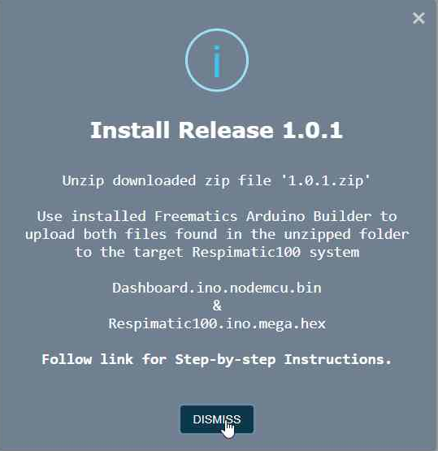
Download Firmware Release Step 3
A .zip is downloaded to your Downloads folder
Read and Dismiss the information popup

Slide 18
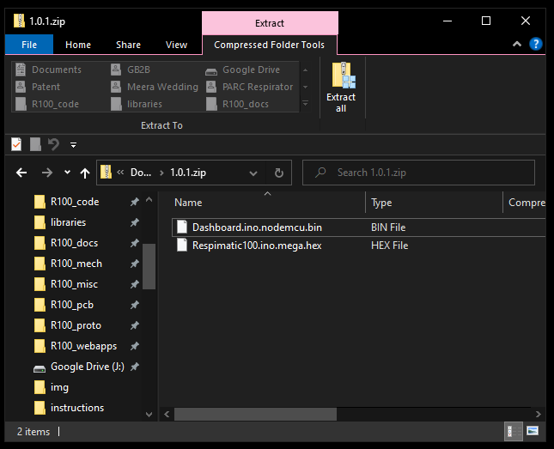
Download Firmware Release Step 4
Double click on the downloaded .zip file to open it
Click on the “Extract All” button

Slide 19
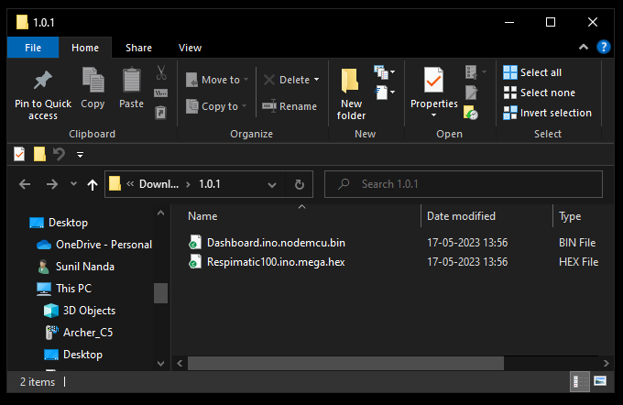
Download Firmware Release Step 5
A folder with the same name as the release tag will be created
It should show two files within it
Dashboard.ino.nodemcu.bin
Respimatic100.ino.mega.hex
Release is now downloaded and ready to be uploaded to the Respimatic system

Slide 20
Install Firmware Release

Slide 21
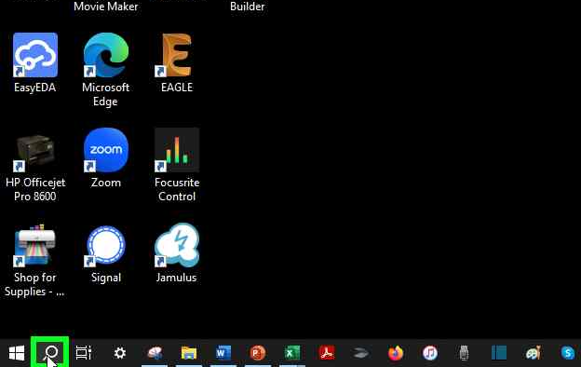
Install Firmware Release Step 1
Search for “Arduino Builder” on the laptop

Slide 22
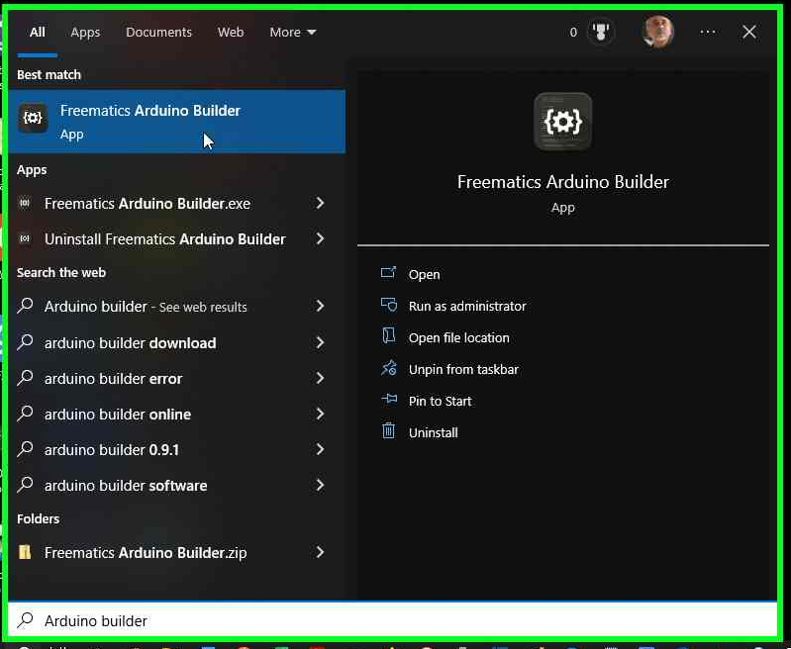
Install Firmware Release Step 2
Click on
“Arduino Builder”
in the search window

Slide 23
Install Firmware Release Step 3
Arduino Builder app window will appear

Slide 24
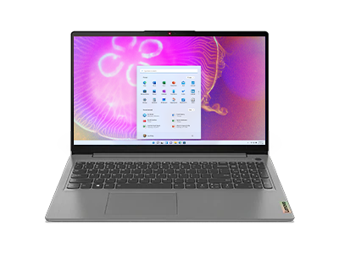
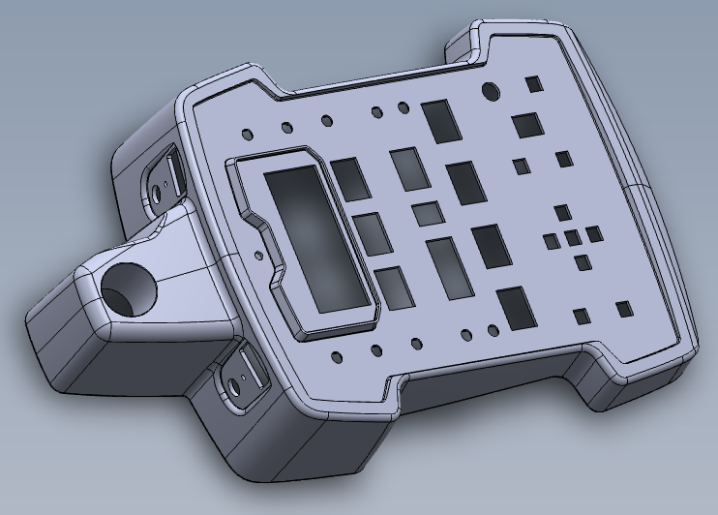
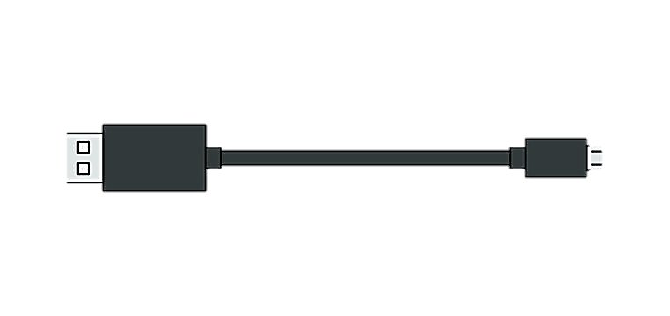
Install Firmware Release Step 4
Connect laptop’s USB port to the micro-USB port labelled “Controller” on the Respimatic system

Slide 25
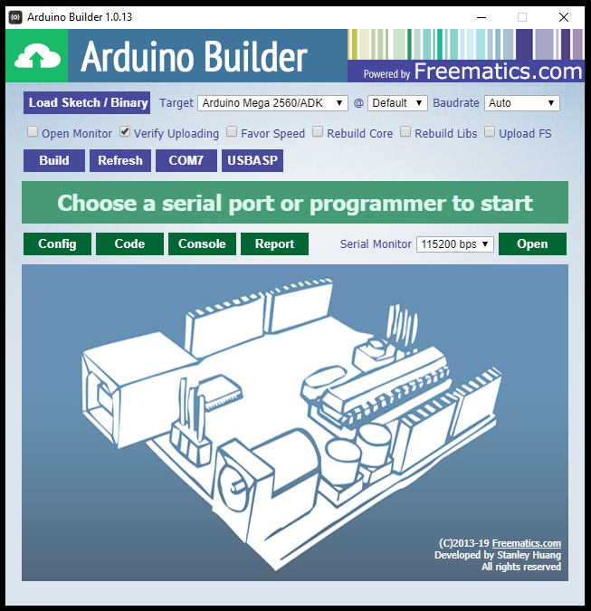
Install Firmware Release Step 6
Select “Arduino Mega 2560/ADK” from the dropdown menu in the “Target” field
Check “Verify” box

Slide 26
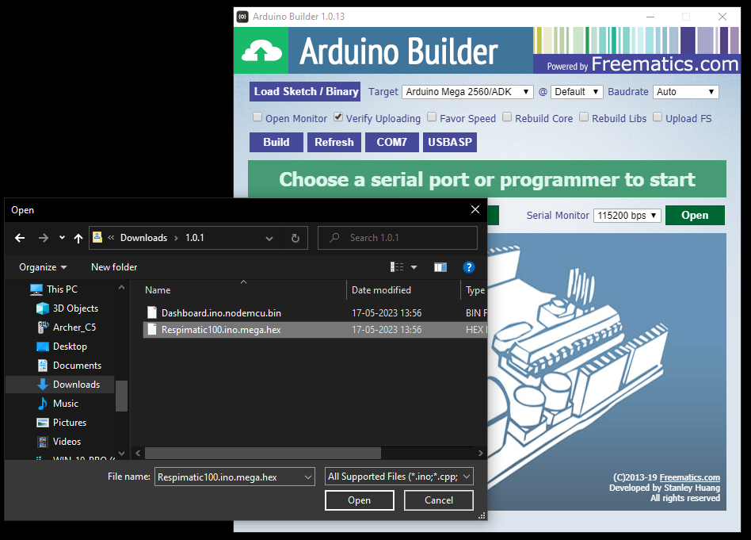
Install Firmware Release Step 7
Click “Load Sketch/Binary” button on the Arduino Builder
Select Respimatic.ino.mega.hex from the extracted folder from the downloaded release

Slide 27
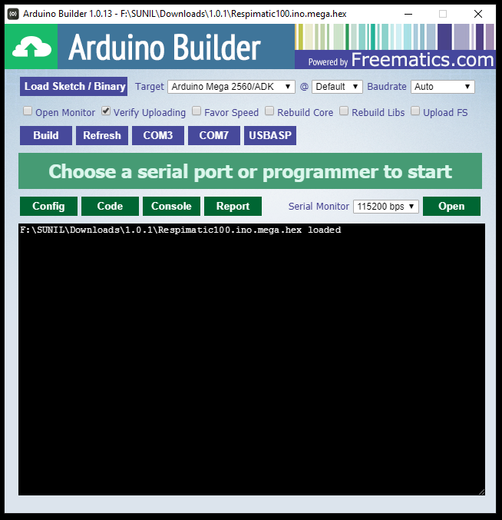
Install Firmware Release Step 8
Check “Refresh” button on the
Arduino Builder
It refreshes the list of COM ports that the Respimatic system could be connected to

Slide 28
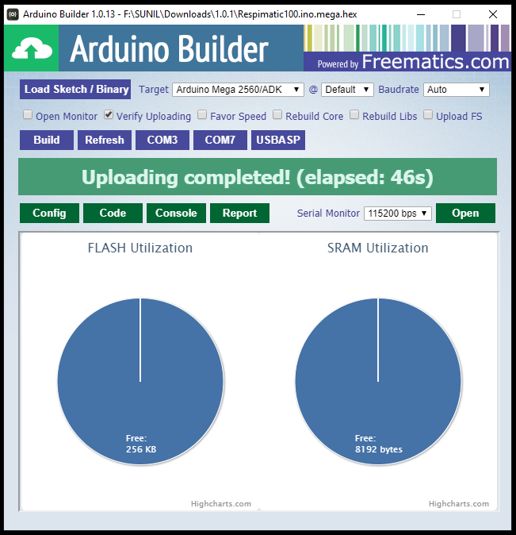
Install Firmware Release Step 9
Click the correct COM port on the Arduino Builder
i.e. the laptop port that the Respimatic system is connected to (in this example it is COM3)
Arduino Builder will now install the selected file on the Respimatic system
Now we need to follow a similar procedure for the other file in the release.

Slide 29
Install Firmware Release Step 10
Connect laptop’s USB port to the micro-USB port labelled “Wi-Fi” on the Respimatic system

Slide 30
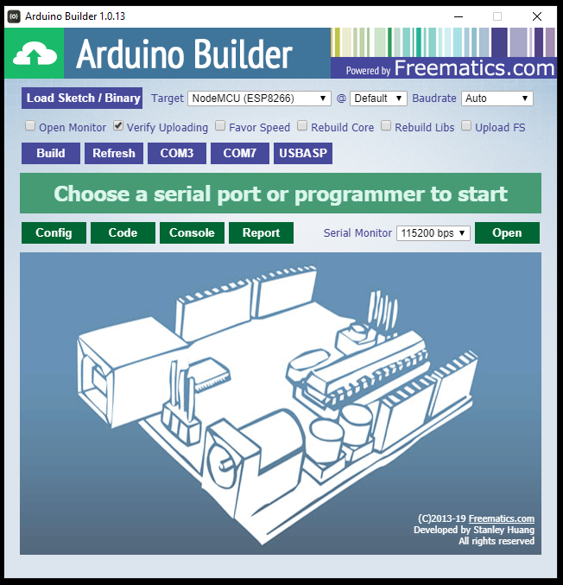
Install Firmware Release Step 11
Select “NodeMCU (ESP8266)” from the dropdown menu in the “Target” field
Check “Verify” box

Slide 31
Install Firmware Release Step 12
Click “Load Sketch/Binary” button on the Arduino Builder
Select Dashboard.ino.nodemcu.bin from the extracted folder from the downloaded release

Slide 32

Install Firmware Release Step 13
Click the correct COM port on the Arduino Builder
i.e. the laptop port that the Respimatic system is connected to (in this example it is COM3)
Arduino Builder will now install the selected file on the Respimatic system
Now we need to follow a similar procedure for the other file in the release.

Slide 33
DONE

